Slide 1



ECEN 404 Final Presentation Team 45: TI Project #3 Alyson Garlick, Diego Gumucio, Meredith McKean, Nicholas McNamara TA: Pranav Dhulipala
Sponsor: Matthew Krebs
Notes:
About 30 seconds

Slide 2
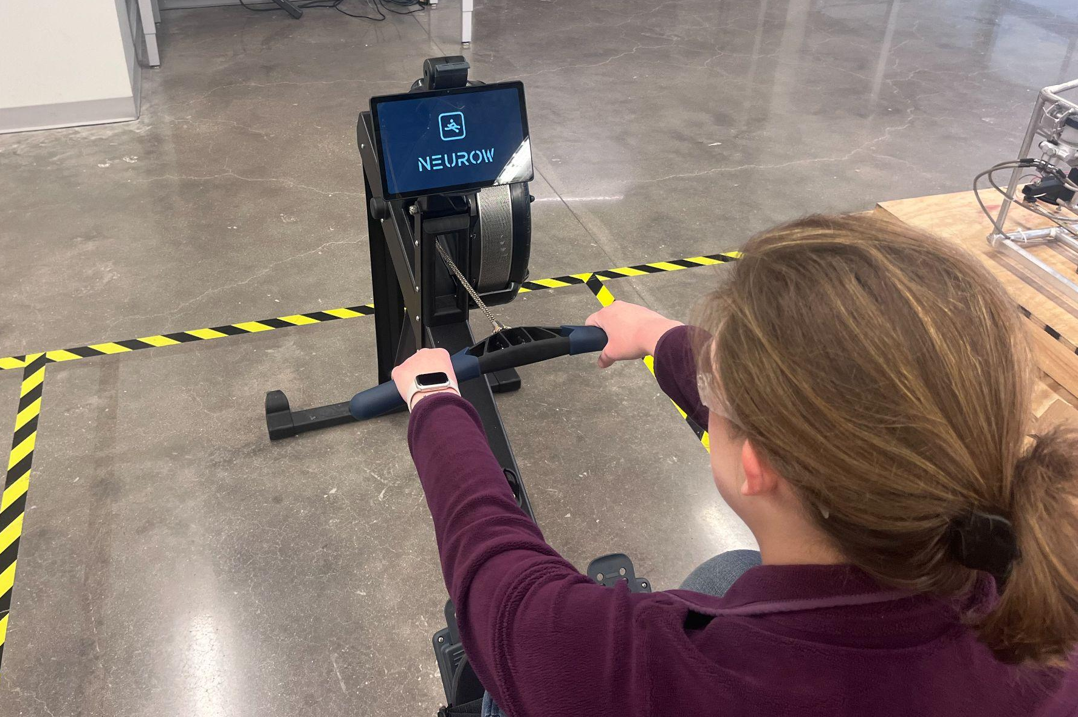
Problem Overview
A problem of older less expensive rower machines is that they lack features of higher end models and those from other types of equipment. These features keep the user engaged and focused on improving their overall fitness via Functional Threshold Power. FTP is a metric to maximize performance gains in the shortest span of time.
To provide this experience, we created an Android application to connect via bluetooth to a Concept2 rower machine and provided:
A measurement of a user’s FTP
Workouts consisting of seven different power zones
Recommendations based on their respective FTP
Storage for user’s history local to the device.
Notes:
Kyle

Slide 3
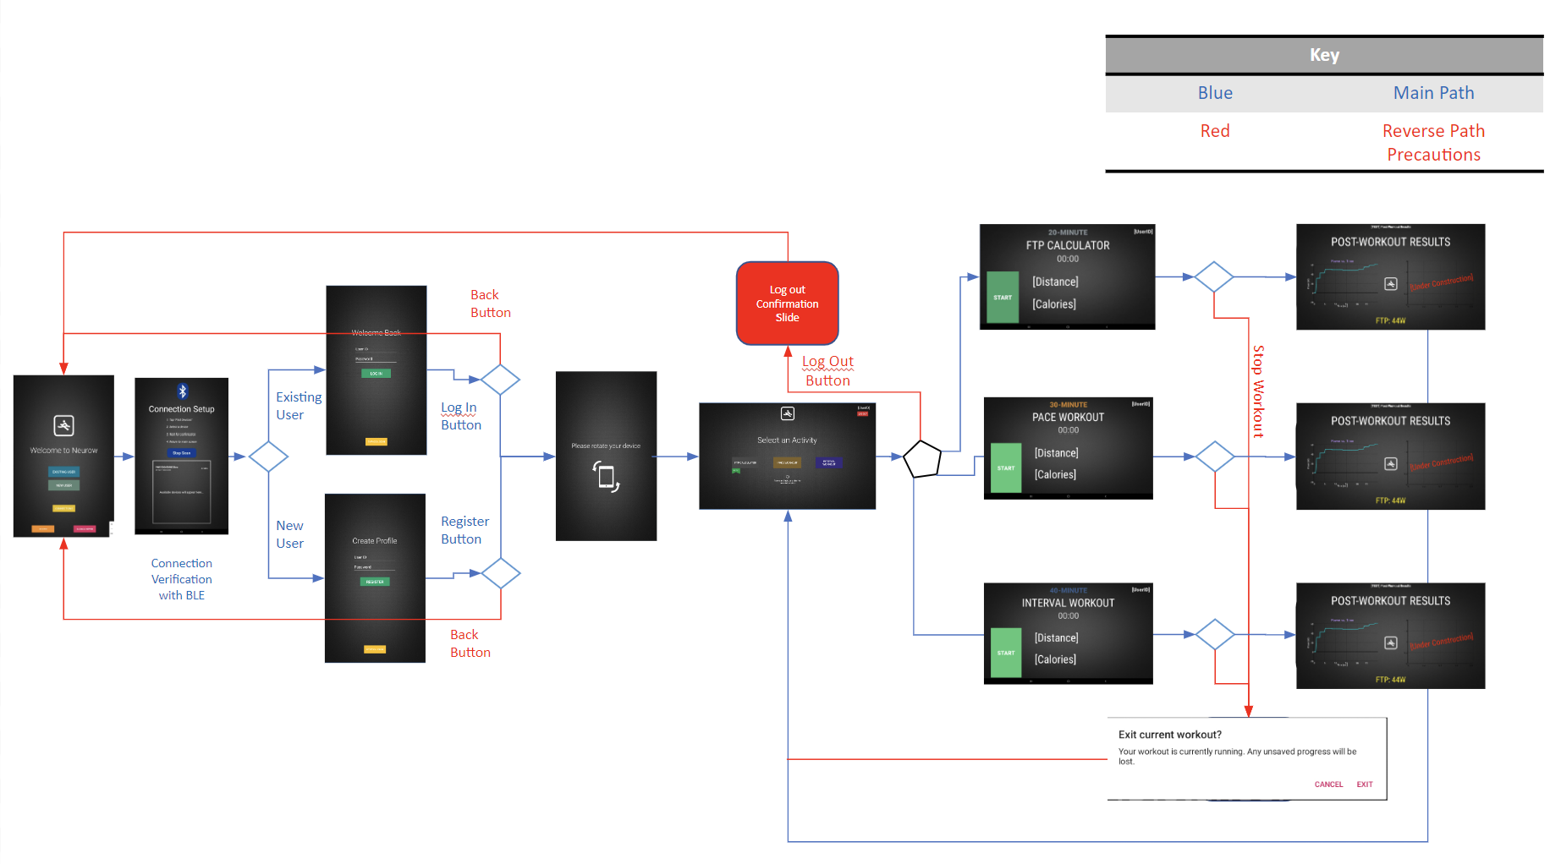
Integrated Project Diagram
Notes:
About 60 seconds

Slide 4
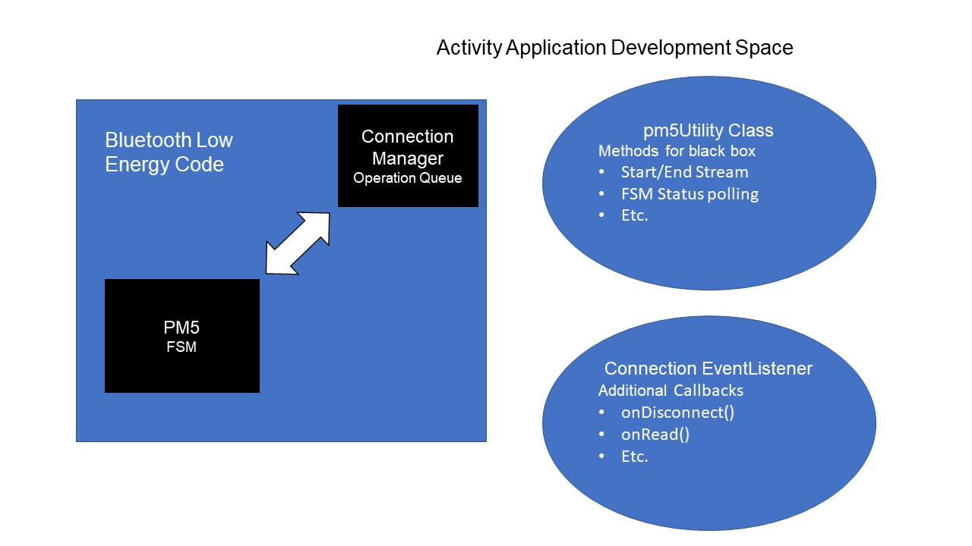
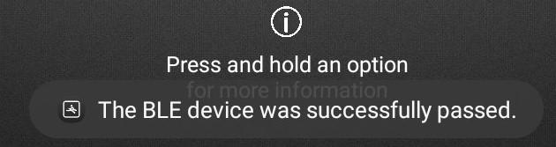
Engineering Design Accomplishments
Nicholas McNamara
Designed:
Utilities class for black boxing operation
Connection Listener overrides
Test & Validation:
Concurrent BLE connection & disconnect
Utility Functions in small driver activity
Parameter passing for Utility & Event Listeners
Notes:
About 60-90 seconds / team member

Slide 5
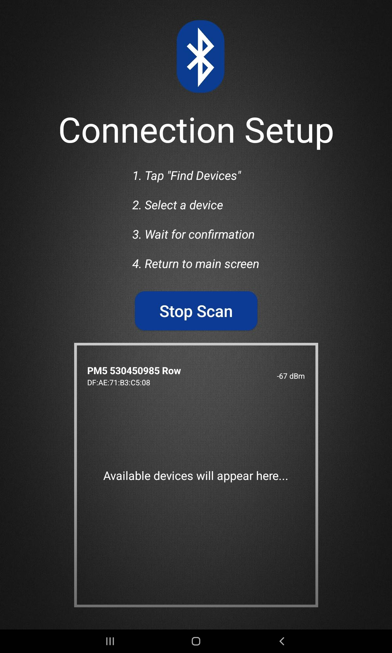
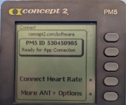
Use Case
Nicholas McNamara
Target:
Commercial Gym
Many Devices of same type in a small area
Distinguishing?
By name in the list view
Comparison to PM5 Unit display name (see below)
Pair
Success brings user back
App flow continues
Notes:
About 60-90 seconds / team member

Slide 6
Challenges, Solutions, & Outcome
Nicholas McNamara
Challenges | Solutions
Device properties don’t match documentation Call functions that require an Activity’s context How to read/change state of PM5 machine Permissions | Enumerate all characteristic properties by enumeration: create callback with new property write Create an event listener with additional callbacks to run inline with activity Send CSAFE short commands and read the STATUS flags through characteristic Update new methods and to prompt for intents on BLE scans
Skills/Knowledge Gained
Kotlin: Nullable types, callbacks, event listeners, lazy initialization, etc.
Android API Levels & Permissions: 21, 31, 33, Install, Runtime, etc.
BLE Devices: GATT hosts vs clients, UUID standardization
CSAFE: Exercise equipment standardization for communication over multiple interfaces
Notes:
About 60-90 seconds / team member (Communications Specification for Fitness Equipment)

Slide 7
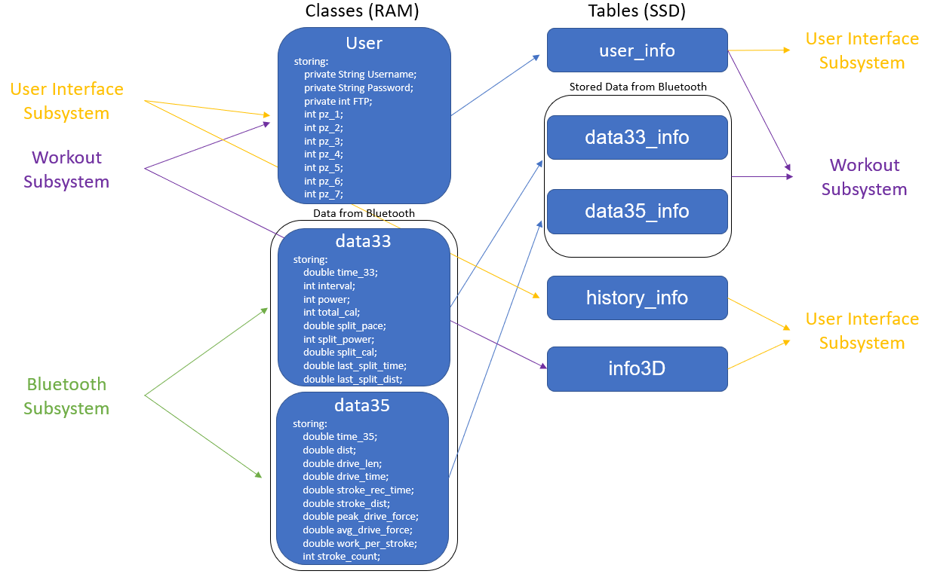
Database Subsystem
Meredith McKean
What I designed:
a local SQLite database written in Kotlin (281 terabytes)
able to store and delete bluetooth data
able to store/update/delete User Profiles for login activity
methods to receive necessary data for Workout activity and UI login in page
What was tested and validated:
storing database with real data
a completed log in activity
workout methods successfully used for workout activity
Notes:
About 60-90 seconds / team member

Slide 8
Database Subsystem
Meredith McKean
Challenges | Solutions
Bluetooth subsystem was written in Kotlin Making Reference to the database outside of an Activity Adding bluetooth data to database simultaneously Github Merging | Translated my Java database to Kotlin passing in database reference through a function restructured our plan, and used an event listener approach to add bluetooth data to the database Created github after merging all subsystems within one app
Skills/Knowledge Gained
Query language and how to organize data for a database
threads and understanding how to run multiple codes at the same time
github push, pull, and rebase commands within Git Bash and Android Studio
Notes:
About 60-90 seconds / team member

Slide 9
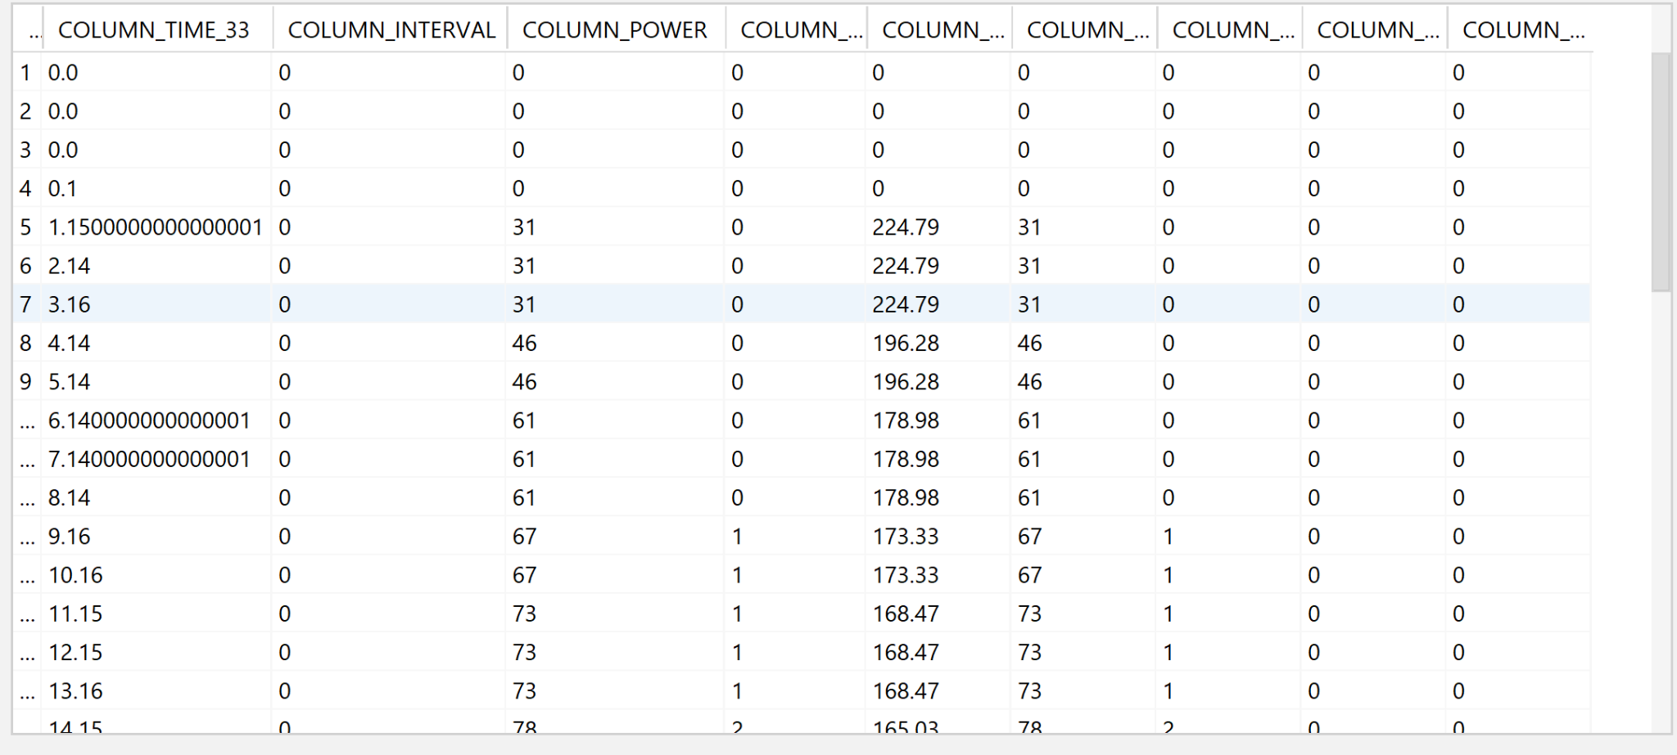
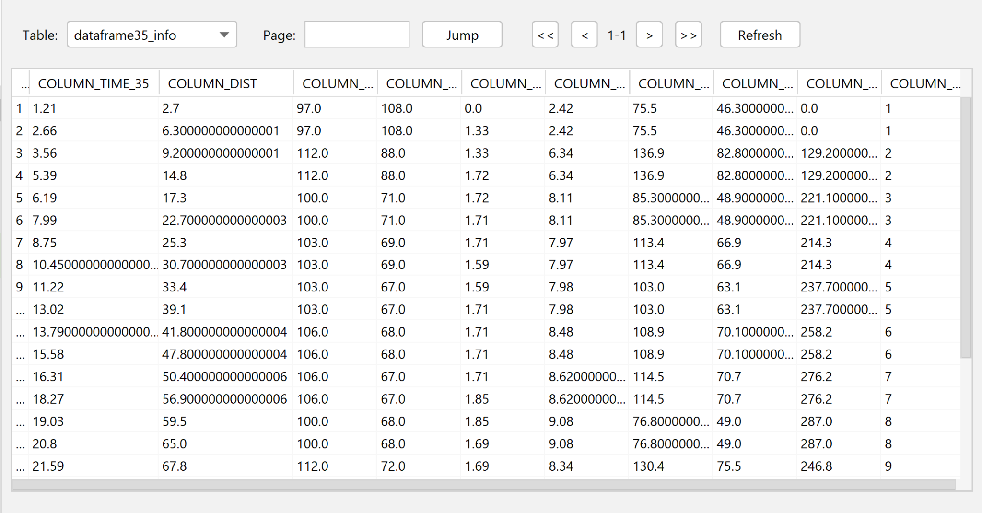
Database Subsystem
Meredith McKean
Notes:
About 60-90 seconds / team member

Slide 10
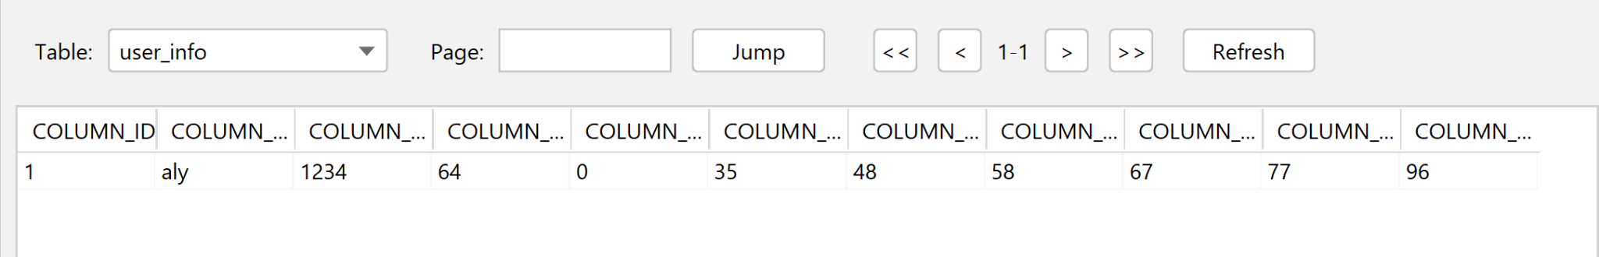
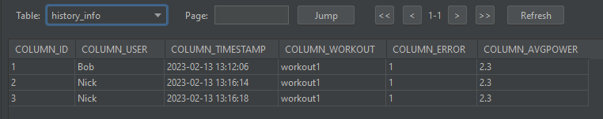
Database Subsystem
Meredith McKean
User_Info
INFO3D
History Table
Notes:
About 60-90 seconds / team member

Slide 11
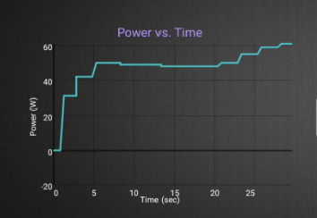
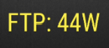
Engineering Design Accomplishments
Alyson Garlick
Designed:
7 workouts available to the user
FTP Calculator, 3 Interval, 3 Pace
Real time feedback based on user performance
Suggestion Method
provide workout suggestion based off of performance
Power Prediction Method
does linear regression on users power history for a workout and predicts power output in future
Power vs Time Graph
preparation of data and method to graph on UI
Power of Pull Graph
how to prepare data and method to graph on UI
Notes:
About 60-90 seconds / team member

Slide 12
Challenges and Solutions
Alyson Garlick
Challenges | Solutions
Inability to populate databases with real time BLE data How to work with only the most current data while within workout methods Issues integrating Java with Kotlin How to display user feedback on UI while in workout method | I created a variable listener class and utilized it within the BLE and UI Activity code to populate database Utilized database method that reads most recent time data Rewrote all code in Kotlin Created listener class that listens for variable changes
Skills/Knowledge Gained
Java/Kotlin, listeners, creating and using classes
Program scheduling and threading
Reinforced git usage knowledge
Heightened programming debugging skills
Notes:
About 60-90 seconds / team member

Slide 13
Test and Validation
Alyson Garlick
Completed:
tested ability to populate database
tested shortened versions of workouts for testing ease
tested power vs time graphing functionality when sent data is empty/null
To Do:
test entire full-length workouts
finish logic of averaging power of pull plot to display
troubleshoot live metric and feedback displaying issue
Notes:
About 60-90 seconds / team member

Slide 14
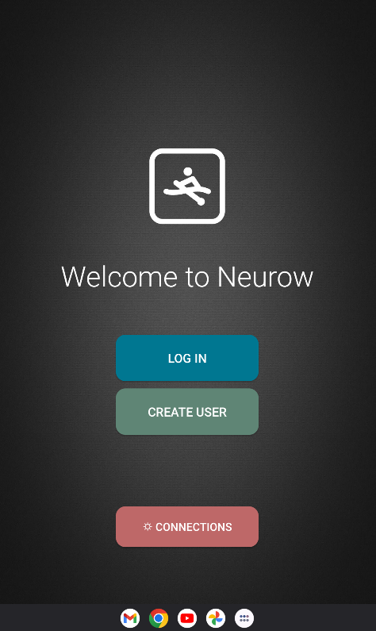
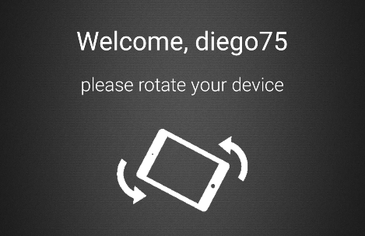
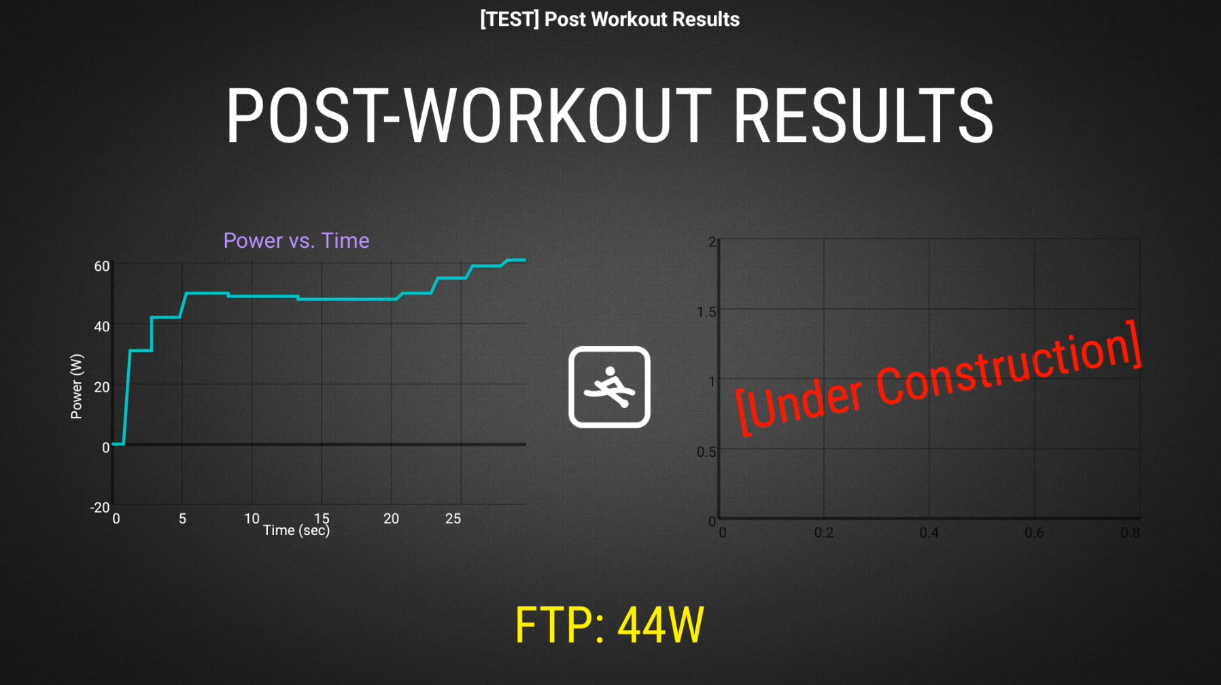
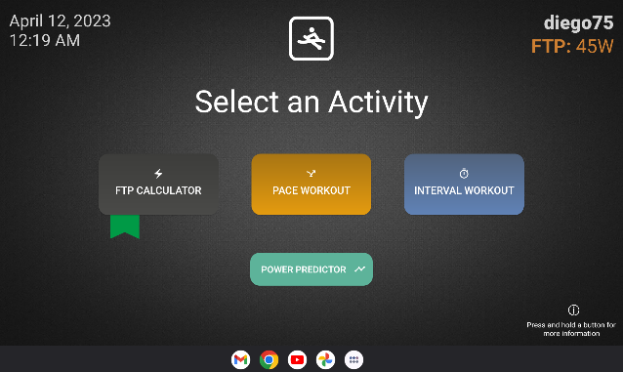
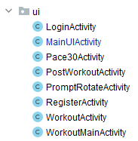
Engineering Design Accomplishments
Diego Gumucio
What I Designed
Visual interface for application
Interactive, dynamic UI elements
Roadmap for activity(screen) launching and traversal
Primary UI behavior controller (back-end)
App logo
Notes:
About 60-90 seconds / team member

Slide 15
Challenges and Solutions
Diego Gumucio
Challenges | Solutions
Layout, spacing, and margins Fixing screen navigation bugs File organization with so many resources like images, gifs, layouts, sublayouts, and values Using handlers to delay animations and UI element setting | Organized each unique activity using Relative/Constraint layout, focused on one screen size Focused on only what’s necessary, simplified function of buttons Creation of file packages for organization Repeatedly used the app myself to find confusing, counterintuitive scenarios
Skills/Knowledge Gained
Learned Kotlin programming from scratch
Reinforced Java skills
Skills managing application build/gradle files
Lots of troubleshooting and error catching in app development
Of course, designing UI
Notes:
About 60-90 seconds / team member

Slide 16

Test and Validation
Diego Gumucio
Completed:
Tested seamless app navigation (with very few bugs)
Completed essential screens like settings, login/register, and more
Achieved an overall UI that is
consistent
concise
provides feedback
I think… looks alright!
To Do:
Display and update UI dynamic working metrics
Finish secondary graph look and formatting (working closely with Alyson)
Notes:
About 60-90 seconds / team member

Slide 17
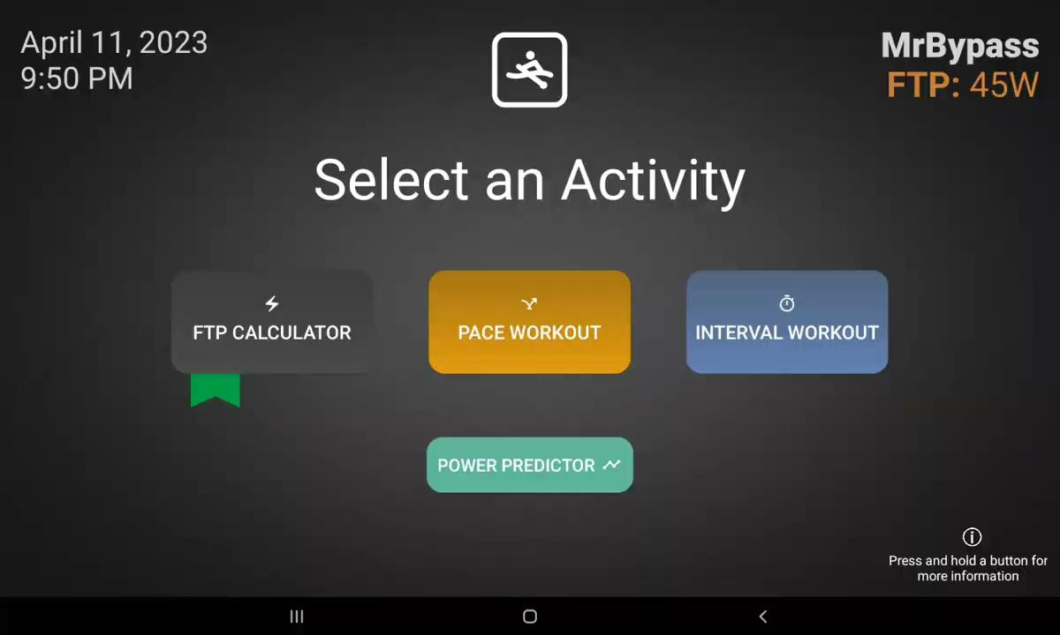
Integrated System Results
Desired workout runtime: 30.00 sec
Result: 31.82 sec.
All systems working together!
BT: sending packaged data
Workout Engine: running ftpCalc workout
Database: being populated by workout engine
UI: displaying everything
Notes:
About 2 minutes total

Slide 18
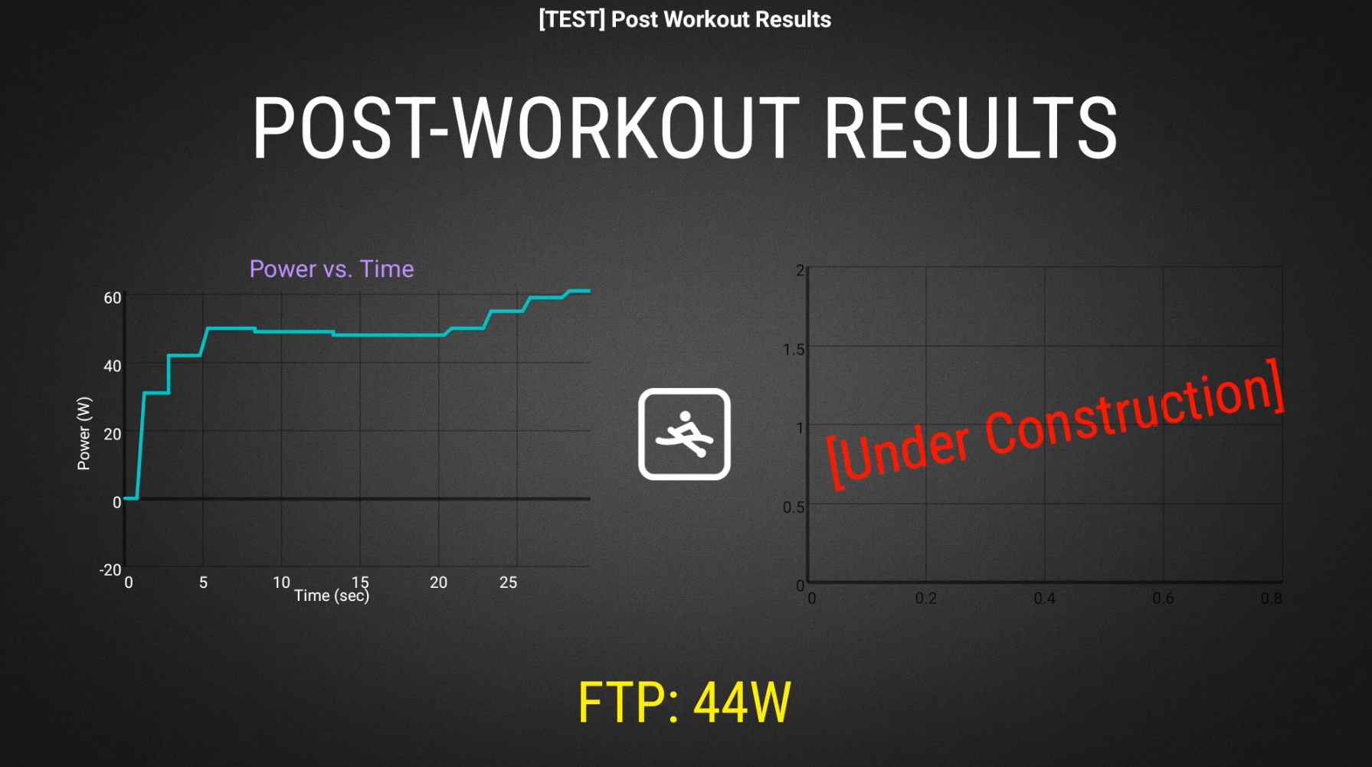

Slide 19
Conclusions
Issues Encountered:
API level incompatibilities
Difficulty integrating Java and Kotlin
Populating database with BLE data
Current Status:
Trying to find bugs and make app unbreakable
Finishing Power of Pull graphing
Fix issues displaying live metrics and feedback
Exhaustive validation of app functionality
Notes:
About 1 minute total

Slide 20
Thank you for listening!

